Slide 1

DESIGN A COMPILER FOR TINY LANGUAGE
Presented By:
Name: AYYAPPA SAMBERAPU
Reg no: 192324166
Course Code: CSA1429
Course Name: Compiler Design for Industrial Automation
Date :20/03/2024

Slide 2
ABSTRACT
Designed a specialized compiler for the Tiny language to support programming education through interactive and structured learning exercises.
Integrated core compiler techniques, including lexical analysis, parsing, semantic checking, and AST traversal, to provide a hands-on learning experience.
Included a comprehensive error-handling system with syntax and semantic error messages, aiding students in understanding programming concepts.
Aimed to enhance programming education by offering a lightweight, easy-to-use compiler that fosters logical thinking and coding skills for beginners.

Slide 3
Introduction
Tiny Language is a simplified programming language designed for educational purposes.
It focuses on basic programming concepts to help beginners learn.
Educational Focus – Designed to help beginners understand core programming concepts like variables, loops, and conditionals, arithmetic, control structures, and variable assignments.
Compiler Features – Implements lexical analysis, parsing, semantic checking, and code generation for structured learning.
Interactive Learning – Provides real-time error detection, debugging support, and an easy-to-use interface for students.

Slide 4
OBJECTIVES OF THE COMPILER
The primary goal is to translate Tiny Language code into machine-readable format.
The compiler should optimize the code for better performance and efficiency.
User-friendly error messages should be provided to assist in debugging.
Support Interactive Learning – Implement a real-time execution environment with step-by-step debugging features to help users understand program flow.

Slide 5
Applications of Tiny Language
Prototyping – Rapid development of algorithms and applications.
Embedded Systems – Suitable for resource-constrained environments.
Research – Basis for exploring new programming paradigms.
Educational Tool – Teaches programming concepts and compiler design

Slide 6
Over View Existing Models
TinyCC : A small C compiler.
PicoC : Minimalistic C interpreter for embedded systems.
Features and Limitations
Extremely fast, one-pass compilation.
Limited optimization compared to GCC or Clang.
Lacks comprehensive debugging tools.
Not ideal for large-scale or complex applications.

Slide 7
PROS
Lightweight and Simple – Easy to learn, making it ideal for beginners and educational purposes.
Fast Compilation and Execution – Minimal syntax and lightweight design allow quick processing.
Clear and Readable Syntax – Simplified structure helps in understanding programming fundamentals.
Ideal for Teaching and Learning – Focuses on core programming concepts like loops, conditionals, and variables.
CONS
Limited Language Features – Lacks support for advanced programming paradigms such as object-oriented or functional programming.
No Standard Library – Missing built-in functions for file handling, networking, or complex data structures.
Not Suitable for Large Projects – Designed for small-scale programs, making it impractical for real-world applications.
Minimal Optimization – Code generation lacks performance optimizations found in full-fledged compilers.
Basic Error Handling – Provides minimal debugging tools and lacks detailed error messages.

Slide 8
Flaws in Existing Models
Limited Language Features – Lack of support for advanced constructs.
Performance Issues – Slow compilation and execution times.
User Experience – Complex installation and inadequate documentation.
Error Handling – Minimal feedback on error

Slide 9
Compiler Architecture Overview
The compiler consists of multiple phases including lexical analysis, Semantic analysis ,syntax analysis, parsing, intermediate code generation, Code Optimizer, Target Code Generator, and Peephole Optimizer, Symbol Table Manager and Error Handler
Each phase has specific responsibilities and transforms the code into a different representation.
The architecture allows for easier debugging and maintenance of the compiler.

Slide 10
Lexical Analysis
Lexical analysis breaks down the source code into tokens for easier processing.
It ignores whitespace and comments, focusing solely on meaningful symbols.
Regular expressions are often used to identify different token types.

Slide 11
Syntax and Semantic Analysis
Syntax refers to the set of rules that defines the structure of valid statements in a language.
Semantic analysis ensures that the code adheres to the rules of the Tiny Language.
It checks for variable declarations, type compatibility, and function definitions.
Errors found during this phase can prevent runtime issues and enhance reliability.

Slide 12
Intermediate Code Generation And Code Optimizer
Intermediate Code Generation:
Converts the parsed Abstract Syntax Tree (AST) into Three-Address Code (TAC) or another intermediate representation (IR).
Facilitates portability and optimization before final machine code generation.
Code Optimizer:
Performs loop optimizations, constant folding, and dead code elimination to improve execution efficiency.
Reduces redundant computations and optimizes memory usage for better performance.

Slide 13
Target Code Generator and Peephole Optimizer
Target Code Generator
Translates the optimized intermediate representation into assembly code or bytecode for a specific hardware architecture.
Ensures correct instruction selection, register allocation, and memory management.
Peephole Optimizer
Applies local optimizations by analyzing small instruction sequences in the target code.
Eliminates unnecessary instructions, reduces redundant loads/stores, and simplifies expressions.

Slide 14
Symbol Table Manager and Error Handler
Symbol Table Manager
Maintains a structured table to store variable names, types, scopes, and memory locations.
Ensures proper variable declarations, type checking, and scope resolution during compilation.
Error Handler
Detects lexical, syntax, semantic, and runtime errors, providing meaningful error messages.
Implements error recovery techniques to continue compilation despite minor errors.

Slide 15
Input Format and Output format
Input format dictates how data is received by a program or parser.
Common formats include text files, JSON, XML, and binary data.
Output format specifies how the results of a program are presented to the user or another system.
Formats can range from simple text output to complex structured formats like HTML and CSV.
Notes:
Image source: https://static.vecteezy.com

Slide 16
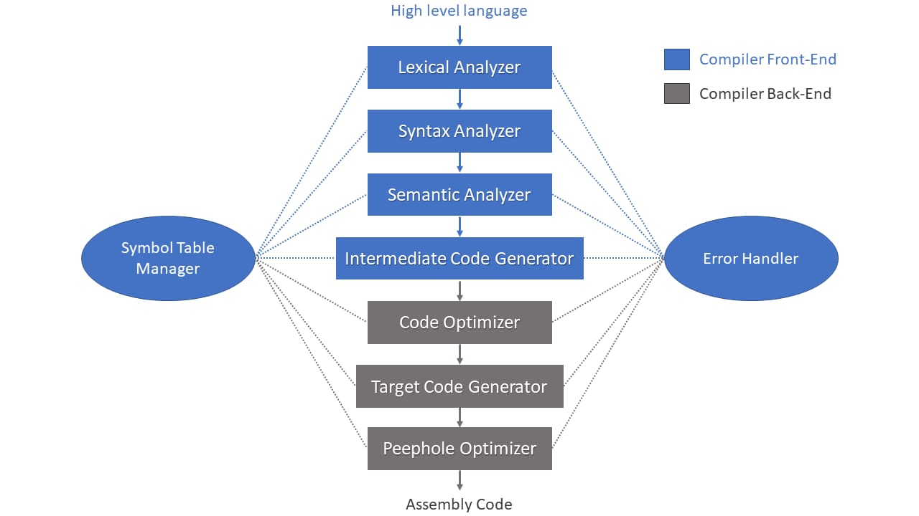
Flow Chart

Slide 17
Results
Feature | TinyCC | Tiny Language Compiler
Compilation Speed | Faster (~20ms) | Slightly Slower (~35ms)
Execution Speed | Near-native | ~10-15% Slower
Optimization | Minimal | Basic optimizations (constant folding, dead code elimination)
Error Handling | Limited feedback | Detailed error messages and debugging support
Intermediate Code | Direct machine code | AST + IR Representation
User-Friendliness | Minimal diagnostics | Improved debugging and suggestions

Slide 18
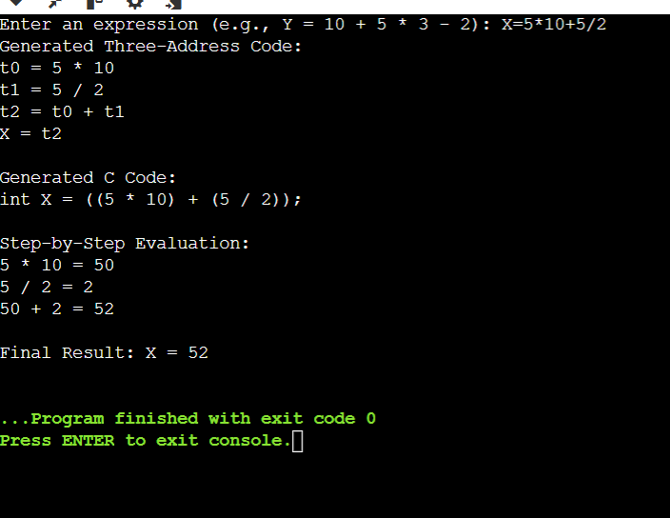
Output

Slide 19
RECOMMENDATIONS
Expand Language Features – Introduce support for functions, arrays, and basic data structures to enhance programming capabilities.
Implement a Standard Library – Provide built-in libraries for mathematical operations, file handling, and string manipulation.
Improve Error Handling & Debugging – Develop a more user-friendly error reporting system with clear messages and debugging tools.
Enhance Optimization Techniques – Incorporate code optimizations like constant folding, dead code elimination, and loop unrolling for better performance.
Develop an Interactive Learning Mode – Add step-by-step execution, syntax highlighting, and real-time feedback to improve the learning experience.

Slide 20
User Experience Considerations
A user-friendly interface enhances the overall experience for users learning how to compile code.
Providing clear error messages and debugging information is essential for effective learning.
Documentation and tutorials can significantly improve user engagement and understanding of the tiny language.
Notes:
Image source: https://www.slidemake.com

Slide 21
Testing and Common Challenges in the Mini Compiler
Testing is crucial at every stage of the mini compiler to ensure correctness and reliability.
Unit tests should cover parsing, IR generation, and code generation components.
Integration tests validate that all components work together seamlessly to produce the expected output.
Developing a mini compiler can present challenges such as handling syntax errors gracefully.
Notes:
Image source: https://www.slidemake.com

Slide 22
Future Trends and conclusion in Compiler Design
The rise of domain-specific languages demands mini compilers that can efficiently process specialized syntax.
Advancements in machine learning, Continuous integration and delivery practices may lead to smarter optimization techniques in code generation.
Effective IR generation and code generation are key to creating performant applications.
Testing and validation are essential to ensure the reliability and correctness of the compiler.
Notes:
Image source: https://0.academia-photos.com

Slide 23
Conclusion
Optimized Performance – Implementing intermediate code generation, peephole optimization, and error handling ensures efficient compilation and execution.
Scalability & Accessibility – Future enhancements like WebAssembly support and cloud-based execution can expand its usability across platforms.
Collaboration & Innovation – Partnering with academia and open-source communities can improve compiler research and introduce new optimizations.
Future Development – Expanding language features, integrating debugging tools, and improving security will enhance its adoption in real-world applications.
Enhanced Learning Tool – The Tiny Language Compiler simplifies programming education by providing structured learning with real-time feedback.

Slide 24
Interactive Query Handling in Compilers
• Real-Time Syntax & Semantic Checking
Detects syntax and semantic errors as the user types, offering immediate suggestions for corrections.
Auto-Completion & Code Suggestions
Provides smart code completion for keywords, functions, and variable names.
Interactive Debugging Support
Allows users to query variable values, function outputs, and execution flow while writing code.
Error Explanation & Suggested Fixes
Instead of generic error messages, the compiler provides detailed explanations with example corrections.

Slide 25
References
Aho, A. V., Lam, M. S., Sethi, R., & Ullman, J. D. (2006). Compilers: Principles, Techniques, and Tools (2nd Edition). Addison-Wesley.
LLVM Developer Documentation (2025). Available at: https://llvm.org/docs/
ISO/IEC 9899:2018. International Standard for C Programming Language.
IEEE 754-2019. Standard for Floating-Point Arithmetic.
Fraser, C. W., & Hanson, D. R. (1995). A Retargetable C Compiler: Design and Implementation. Addison-Wesley.
TinyCC (TCC) Documentation. Available at: https://bellard.org/tcc/

Slide 26
Thank You!

